Slide 1
Software Architecture and Design
Lecture 3

Slide 2
What is a model?
A model is a representation in a certain medium of something in the same or another medium.
The model captures the important aspects of the thing being modeled from a certain point of view and simplifies or omits the rest.
Engineering, architecture, and many other creative fields use models.
A model is expressed in a medium that is convenient for working. Models of buildings may be drawings on paper, 3-D figures made of cardboard.
A construction model of a building shows the appearance of the building but can also be used to make engineering and cost calculations.
A model of a software system is made in a modeling language, such as UML.
The model has both semantics and notation and can take various forms that include both pictures and text.
The model is intended to be easier to use for certain purposes than the final system.

Slide 3
What are models for?
To capture and precisely state requirements and domain knowledge so that all stakeholders may understand and agree on them.
To think about the design of a system.
To capture design decisions in a mutable form separate from the requirements.
To generate usable work products.
To organize, find, filter, retrieve, examine, and edit information about large systems.
To master complex systems.

Slide 4
UML (Unified Modelling Language)
UML is a standard language for specifying, visualizing, constructing, and documenting the artifacts of software systems.
UML was created by Object Management Group OMG and UML 1.0 specification draft was proposed to the OMG in January 1997.
OMG is continuously putting effort to make a truly industry standard.
UML stands for Unified Modeling Language.
UML is different from the other common programming languages like C++, Java, COBOL etc.
UML is a pictorial language used to make software blue prints.

Slide 5
Covered Modelling Diagrams
Scenarios/Use Cases
Use case Diagram
Sequence Diagram
Class Diagram
Communication Diagram
Activity Diagram
Component Diagram
Package Diagram
Deployment Diagram

Slide 6
Scenarios/Use Case (Technique for Use case Identification)
User Goal Technique
This is a rather obvious approach that involves talking to users and getting them to discuss their goals for the new system. The analyst would typically list all the stakeholders who are likely to interact with the system, think through their roles and identify what they would need to get their work done.
By analyzing existing systems and asking users how they would like to use the new system, the analyst can come up with an array of use cases. Use cases are thus, a combination of existing system functions and newly requested functions.

Slide 7
Scenarios/Use Case(Technique for Use case Identification)
CRUD Technique
Another technique used for identifying use cases is CRUD, an acronym for Create, Read or Report, Update and Delete. Here, the analyst identifies all the data elements to be processed by the system and creates use cases that create, report on, update, and delete the data items. Here’s a guide to using the CRUD technique, using an online ordering website as an example:
Identify the data items to be handled by the system. The data items involved relate to customer, order, inventory item and shipment.
Examine each data item and state the use cases that create the data; read or report on the data; update the data; and delete the data.

Slide 8
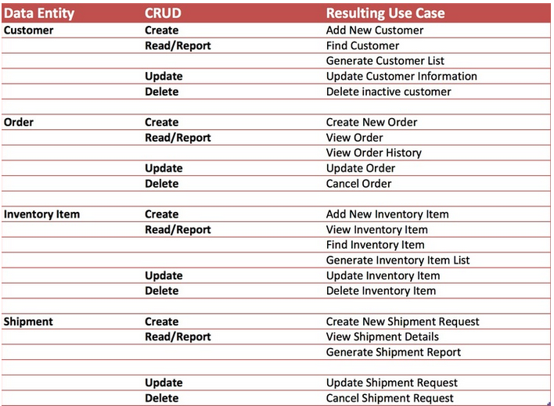

Slide 9

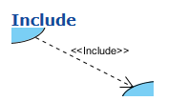
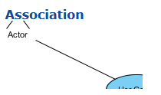
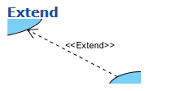

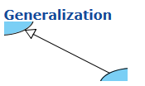
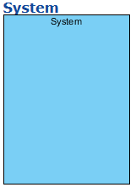
Use Case Diagram Notations
Use Case

Slide 10
Cont.…
Use Case
A use case is the specification of a set of actions performed by a system, which yields an observable result that is typically of value for one or more actors or other stakeholders of the system.
Association
An Actor and use case can be associated to indicate that the actor participates in that use case. Therefore, an association correspond to a sequence of actions between the actor and use case in achieving the use case.
Actor
Actors are the entities that interact with a system. Although in most cases, actors are used to represent the users of system, actors can actually be anything that needs to exchange information with the system. So, an actor may be people, computer hardware, other systems, etc.

Slide 11
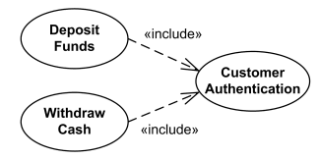

Cont.…
System
The scope of a system can be represented by a system (shape), or sometimes known as a system boundary. The use cases of the system are placed inside the system shape, while the actor who interact with the system are put outside the system. The use cases in the system make up the total requirements of the system.
Include
An include relationship specifies how the behavior for the inclusion use case is inserted into the behavior defined for the base use case.
Extend
An extend relationship specifies how the behavior of the extension use case can be inserted into the behavior defined for the base use case.

Slide 12
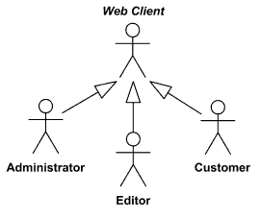
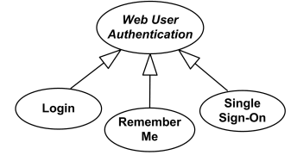
Cont.…
Generalization
A generalization relationship is used to represent inheritance relationship between model elements of same type. The more specific model element share the same specification with the more general model element but carries more details in extra.

Slide 13
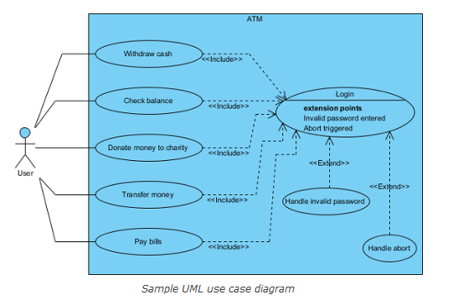

Slide 14
Writing a Use Case
Name – A clear verb/noun or actor/verb/noun descriptor that communicates the scope of the use case.
Brief Description – A brief paragraph of text describing the scope of the use case.
Actors – A list of the types of users who can engage in the activities described in the use case.
Preconditions – Anything the solution can assume to be true when the use case begins.
Basic Flow – The set of steps the actors take to accomplish the goal of the use case. A clear description of what the system does in response to each user action.
Alternate Flows – Capture the less common user/system interactions, such as being on a new computer and answering a security question.
Post Conditions – Anything that must be true when the use case is complete.

Slide 15
Use Case – ATM Example
Actors:
ATM Customer
ATM Operator
Use Cases:
The customer can
withdraw funds from a checking or savings account
query the balance of the account
transfer funds from one account to another
The ATM operator can
Shut down the ATM
Replenish the ATM cash dispenser
Start the ATM

Slide 16
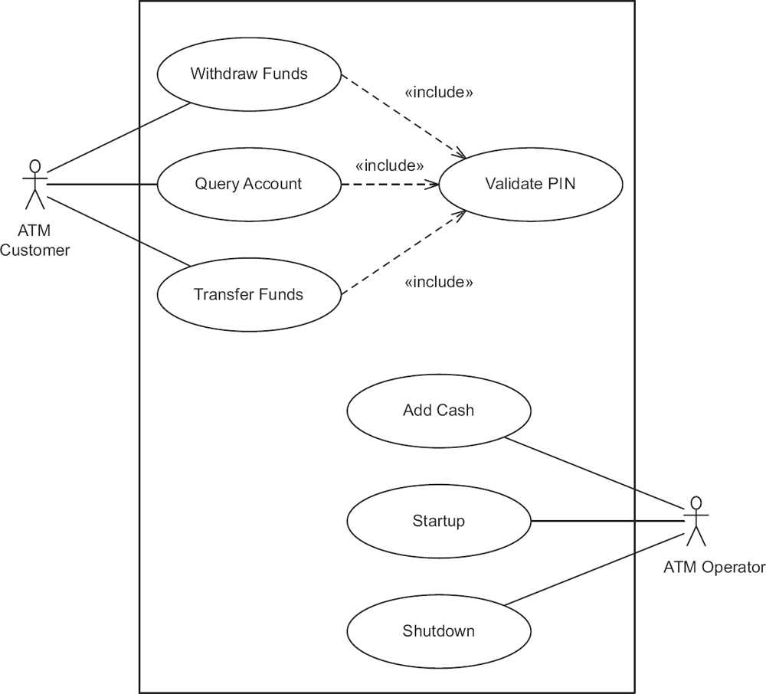
Use Case – ATM Example
Notes:
It can be seen that the first part of each use case - namely, reading the ATM card and validating the customer's PIN - is common to all three use cases. This common part of the three use cases is factored out as an inclusion use case called Validate PIN.

Slide 17
Use Case – ATM Example
Validate PIN is an Inclusion Use Case
It cannot be executed on its own
Must be executed as part of a Concrete Use Case
On the other hand, a Concrete Use Case can be executed
Notes:
Inclusion use cases always reflect functionality that is common to more than one use case. When this common functionality is separated into an inclusion use case, the inclusion use case can be reused by several base (executable) use cases. Inclusion use cases can often be developed only after an initial iteration in which several use cases have been developed. Only then can repeated sequences of interactions be observed that form the basis for the inclusion use cases.

Slide 18
Use Case – Validate PIN (1)
Use case name: Validate PIN
Brief Description/Summary: System validates customer PIN
Actor: ATM Customer
Precondition: ATM is idle, displaying a Welcome message.

Slide 19
Use Case – Validate PIN (2)
Main sequence:
Customer inserts the ATM card into the card reader.
If system recognizes the card, it reads the card number.
System prompts customer for PIN.
Customer enters PIN.
System checks the card's expiration date and whether the card has been reported as lost or stolen.
If card is valid, system then checks whether the user-entered PIN matches the card PIN maintained by the system.
If PIN numbers match, system checks what accounts are accessible with the ATM card.
System displays customer accounts and prompts customer for transaction type: withdrawal, query, or transfer.

Slide 20
Use Case – Validate PIN (3)
Alternative sequences:
Step 2: If the system does not recognize the card, the system ejects the card.
Step 5: If the system determines that the card date has expired, the system confiscates the card.
Step 5: If the system determines that the card has been reported lost or stolen, the system confiscates the card.
Step 7: If the customer-entered PIN does not match the PIN number for this card, the system re-prompts for the PIN.
Step 7: If the customer enters the incorrect PIN three times, the system confiscates the card.
Steps 4-8: If the customer enters Cancel, the system cancels the transaction and ejects the card.
Postcondition: Customer PIN has been validated.

Slide 21
Use Case – Withdraw Funds (1)
Use case name: Withdraw Funds
Summary: Customer withdraws a specific amount of funds from a valid bank account.
Actor: ATM Customer
Dependency: Include Validate PIN use case.
Precondition: ATM is idle, displaying a Welcome message.

Slide 22
Use Case – Withdraw Funds (2)
Main sequence:
Include Validate PIN use case.
Customer selects Withdrawal, enters the amount, and selects the account number.
System checks whether customer has enough funds in the account and whether the daily limit will not be exceeded.
If all checks are successful, system authorizes dispensing of cash.
System dispenses the cash amount.
System prints a receipt showing transaction number, transaction type, amount withdrawn, and account balance.
System ejects card.
System displays Welcome message.

Slide 23
Use Case – Withdraw Funds (3)
Alternative sequences:
Step 3: If the system determines that the account number is invalid, then it displays an error message and ejects the card.
Step 3: If the system determines that there are insufficient funds in the customer's account, then it displays an apology and ejects the card.
Step 3: If the system determines that the maximum allowable daily withdrawal amount has been exceeded, it displays an apology and ejects the card.
Step 5: If the ATM is out of funds, the system displays an apology, ejects the card, and shuts down the ATM.
Post condition: Customer funds have been withdrawn.

